Slide 1
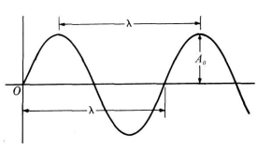
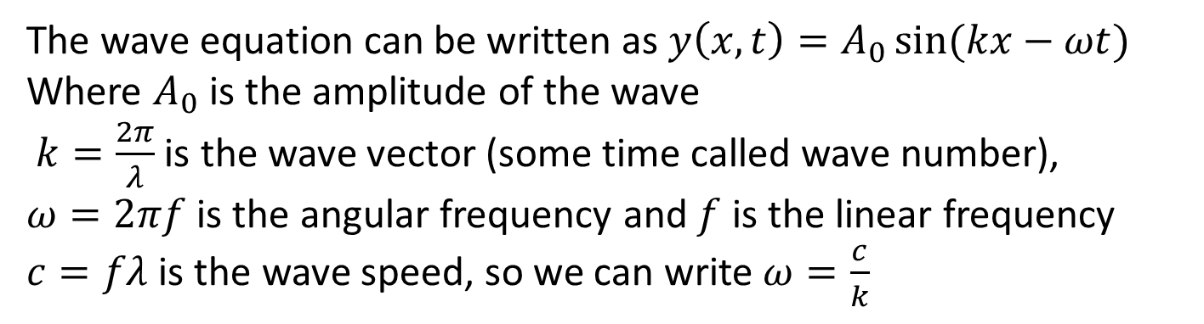
Waves in a Box
The wave equation can be written as $y\left(x,t\right)=A_{0}\sin{(kx−ωt)}$
Where $A_{0}$ is the amplitude of the wave
$k=\frac{2π}{λ}$ is the wave vector (some time called wave number),
$ω=2πf$ is the angular frequency and $f$ is the linear frequency
$c=fλ$ is the wave speed, so we can write $ω=\frac{c}{k}$

Slide 2
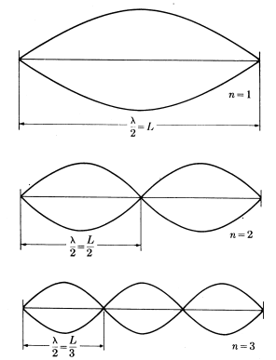
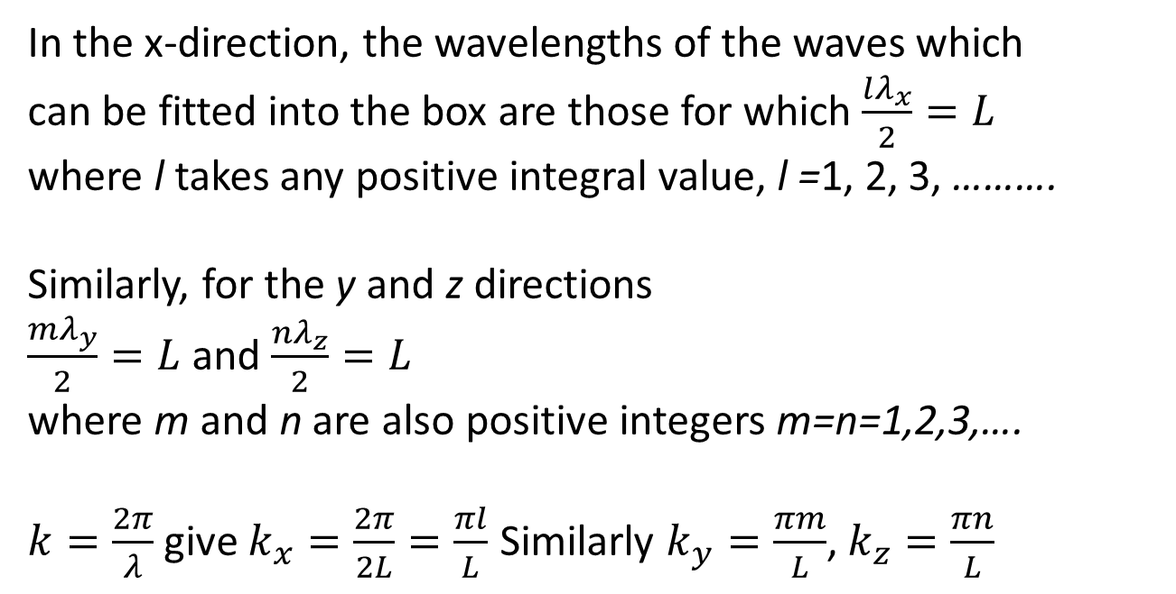
Electromagnetic Modes in a Box
Consider a cubical box of side L and imagine waves bouncing back and forth inside it. The box has fixed, rigid, perfectly conducting walls. Therefore, the electric field of the electromagnetic wave must be zero at the walls of the box and so we can only fit waves into the box which are multiples of half a wavelength.
In the x-direction, the wavelengths of the waves which
can be fitted into the box are those for which $\frac{lλ_{x}}{2}=L$
where l takes any positive integral value, l =1, 2, 3, ……….
Similarly, for the y and z directions $\frac{mλ_{y}}{2}=L$ and $\frac{nλ_{z}}{2}=L$
where m and n are also positive integersm=n=1,2,3,….
$k=\frac{2π}{λ}$ give $k_{x}=\frac{2π}{2L}=\frac{πl}{L}$ Similarly $k_{y}=\frac{πm}{L}$, $k_{z}=\frac{πn}{L}$

Slide 3
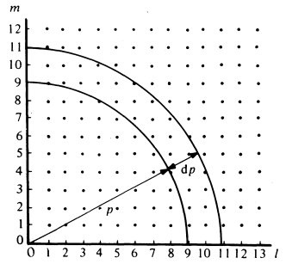


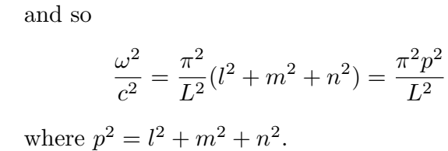
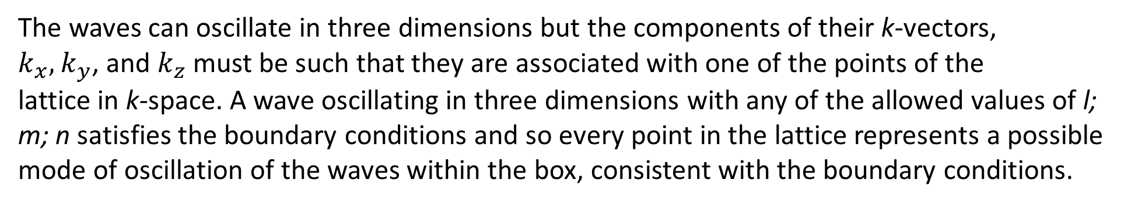
The waves can oscillate in three dimensions but the components of their k-vectors,
$k_{x},k_{y}$, and $k_{z}$ must be such that they are associated with one of the points of the lattice in k-space. A wave oscillating in three dimensions with any of the allowed values of l; m; n satisfies the boundary conditions and so every point in the lattice represents a possible mode of oscillation of the waves within the box, consistent with the boundary conditions.
Thus, in three dimensions, the modes of oscillation can be written

Slide 4
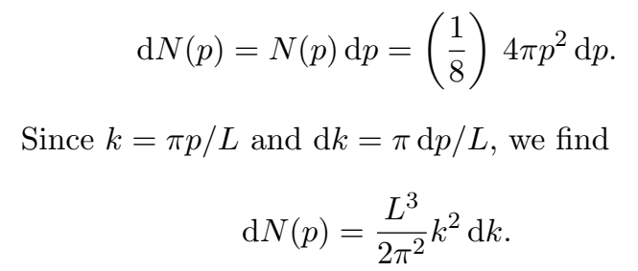
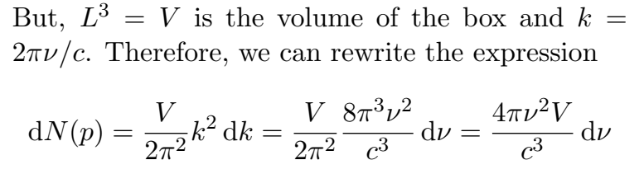
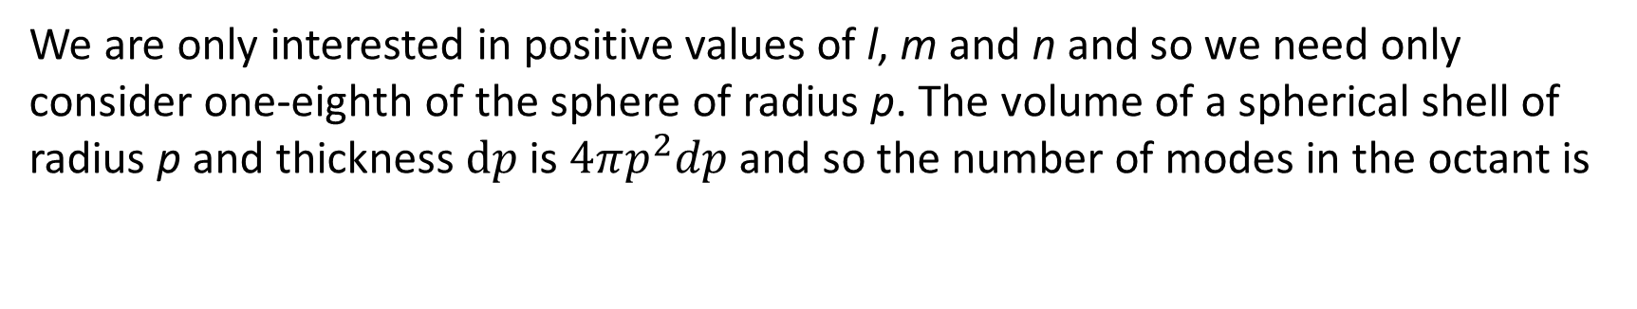
Counting the Modes
We need to count the number of modes between the frequency $ν$ to$ν+dν$
We are only interested in positive values of l, m and n and so we need only consider one-eighth of the sphere of radius p. The volume of a spherical shell of radius p and thickness $dp$ is $4πp^{2}dp$and so the number of modes in the octant is

Slide 5
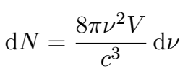

Finally, for electromagnetic waves, we are always allowed two independent modes per state so we must multiply the result by 2.

Slide 6

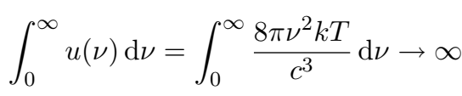
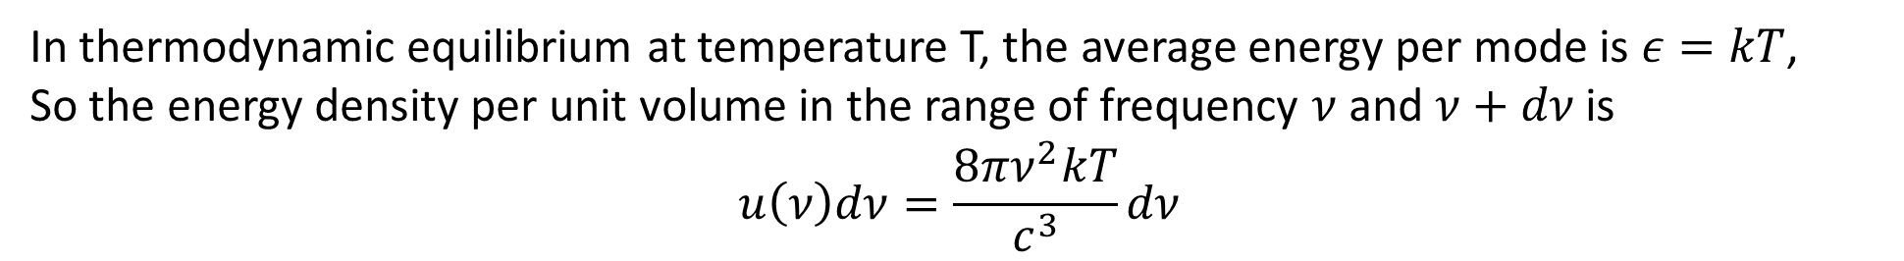
The Average Energy per Mode and the Ultraviolet Catastrophe
In thermodynamic equilibrium at temperature T, the average energy per mode is $ε=kT$,
So the energy density per unit volume in the range of frequency $ν$ and $ν+dν$ is
$$u\left(ν\right)dν=\frac{8πν^{2}kT}{c^{3}}dν$$
This classical law failed, because energy diverge at high frequency, that is

Slide 7
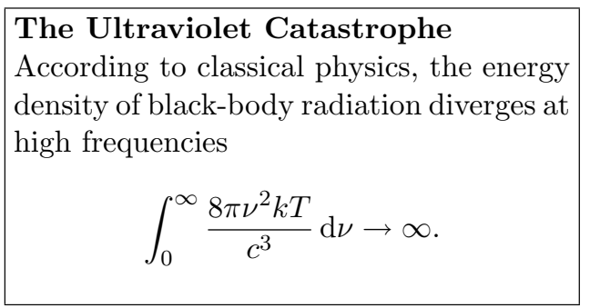
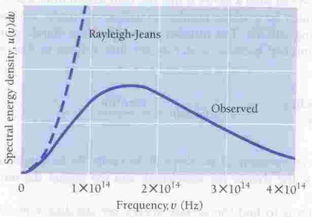
According to this law the energy of a black body is infinite which is impossible!!! Although this law can not explain the radiation curve of a black body at high temperature, it can perfectly explain the black body radiation at low temperature.
This result was derived by Lord Rayleigh in 1900. This was one of the key problems of classical physics!! what has gone wrong?

Slide 8
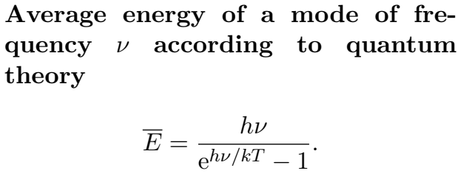
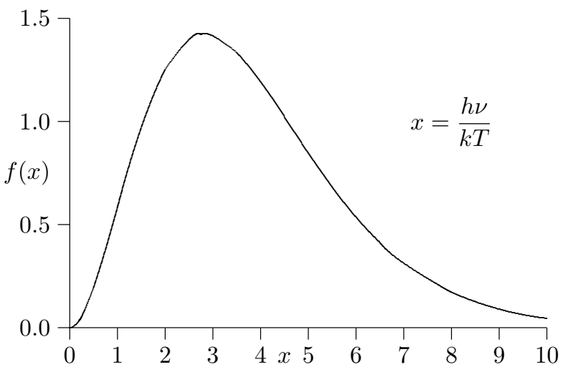
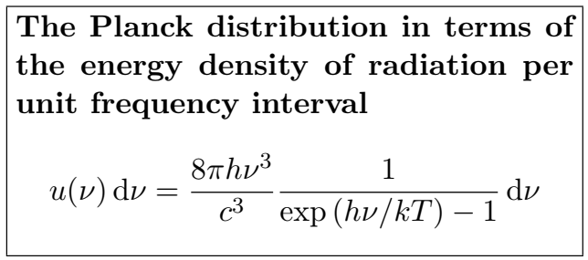
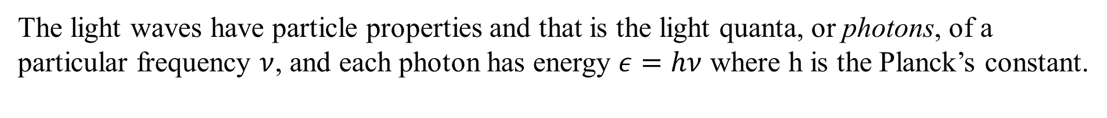
Planck Law of black body radiation
The light waves have particle properties and that is the light quanta, or photons, of a particular frequency $ν$, and each photon has energy $ε=hν$ where h is the Planck’s constant.

Slide 9
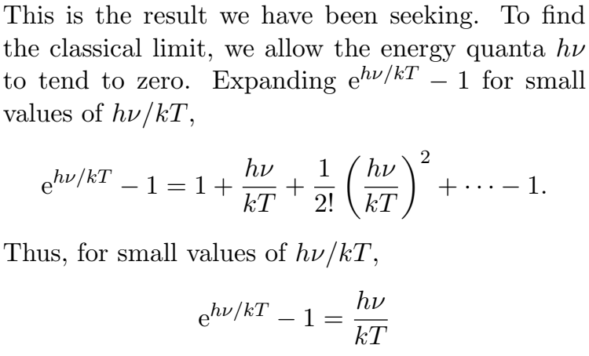

Classical Limit in low frequency
Thus, if we take the classical limit, we recover exactly the expression for the average energy of the classical oscillator as was used in Rayleigh-Jean’s law.

Slide 10
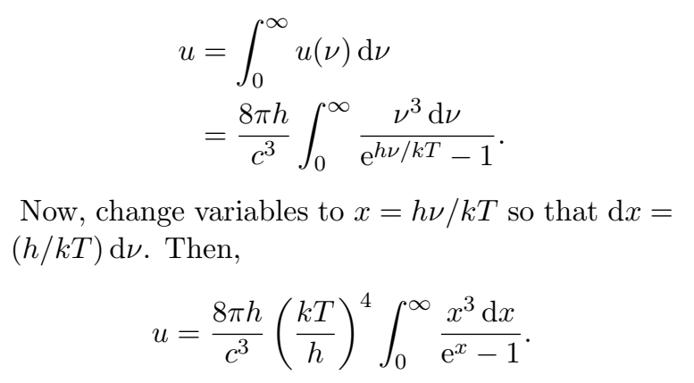
The Stefan-Boltzmann Law
Let us calculate the total energy of the emitted radiation by integrating the Planck spectrum over all wavelengths. This will give the dependence of the total energy density of radiation u upon temperature.

Slide 11
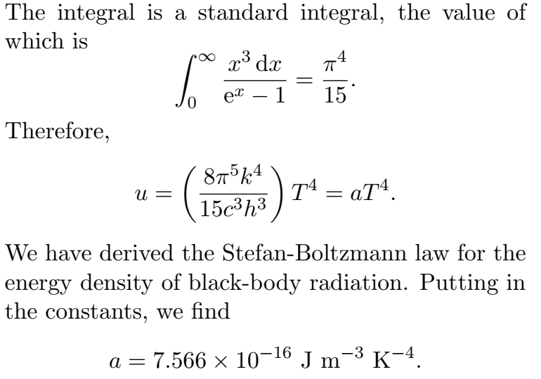

Slide 12
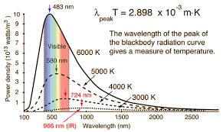
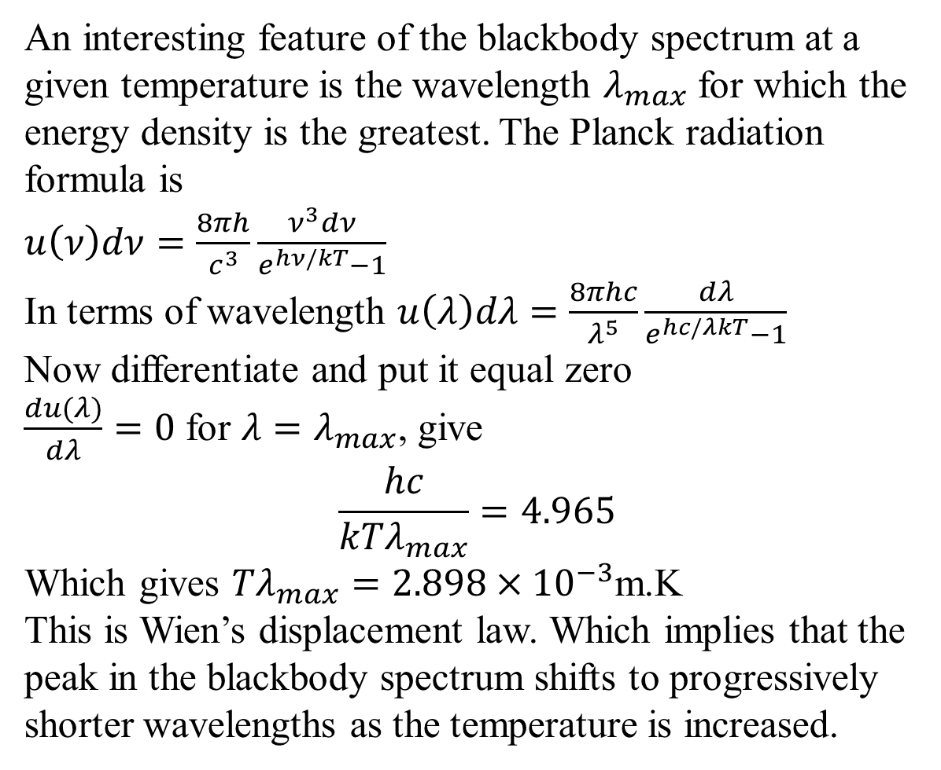
Wien’s Displacement Law
An interesting feature of the blackbody spectrum at a given temperature is the wavelength $λ_{max}$ for which the energy density is the greatest. The Planck radiation formula is
$$u\left(ν\right)dν=\frac{8πh}{c^{3}}\frac{ν^{3}dν}{e^{hν/kT}−1}$$
In terms of wavelength $u\left(λ\right)dλ=\frac{8πhc}{λ^{5}}\frac{dλ}{e^{hc/λkT}−1}$
Now differentiate and put it equal zero
$\frac{du(λ)}{dλ}=0$ for $λ=λ_{max}$, give
$$\frac{hc}{kTλ_{max}}=4.965$$
Which gives $Tλ_{max}={2.898×10}^{−3}$m.K
This is Wien’s displacement law. Which implies that the peak in the blackbody spectrum shifts to progressively shorter wavelengths as the temperature is increased.

Slide 13
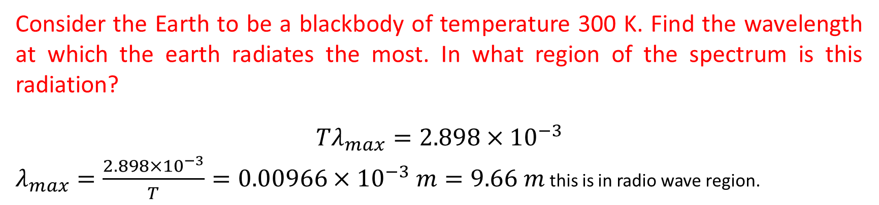
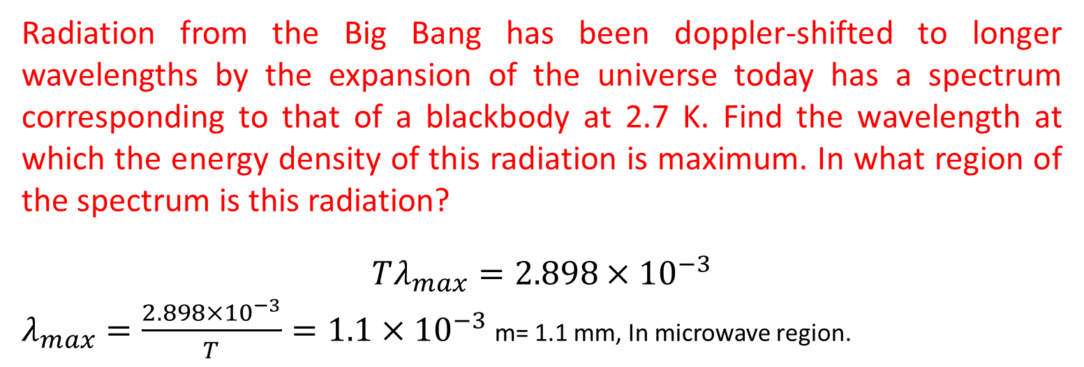
Radiation from the Big Bang has been doppler-shifted to longer wavelengths by the expansion of the universe today has a spectrum corresponding to that of a blackbody at 2.7 K. Find the wavelength at which the energy density of this radiation is maximum. In what region of the spectrum is this radiation?
$$Tλ_{max}={2.898×10}^{−3}$$
$λ_{max}=\frac{{2.898×10}^{−3}}{T}={1.1×10}^{−3}$m= 1.1 mm, In microwave region.
Consider the Earth to be a blackbody of temperature 300 K. Find the wavelength at which the earth radiates the most. In what region of the spectrum is this radiation?
$$Tλ_{max}={2.898×10}^{−3}$$
$λ_{max}=\frac{{2.898×10}^{−3}}{T}={0.00966×10}^{−3} m=9.66 m$ this is in radio wave region.

Slide 14
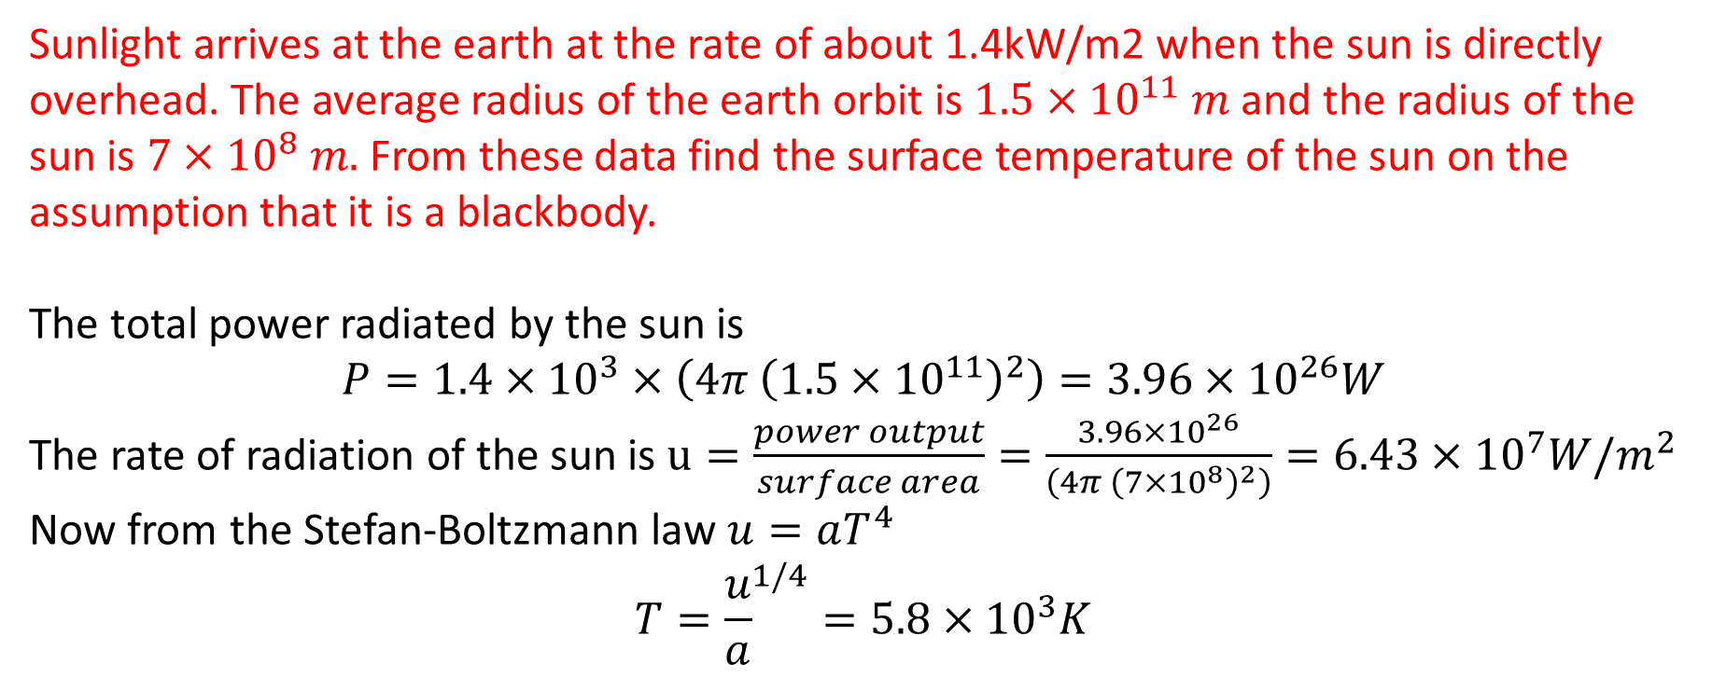
Sunlight arrives at the earth at the rate of about 1.4kW/m2 when the sun is directly overhead. The average radius of the earth orbit is ${1.5×10}^{11} m$ and the radius of the sun is ${7×10}^{8} m.$ From these data find the surface temperature of the sun on the assumption that it is a blackbody.
The total power radiated by the sun is
$$P={1.4×10}^{3}×\left(4π {\left({1.5×10}^{11}\right)}^{2}\right)={3.96×10}^{26}W$$
The rate of radiation of the sun is $u=\frac{power output}{surface area}=\frac{{3.96×10}^{26}}{\left(4π {\left({7×10}^{8}\right)}^{2}\right)}={6.43×10}^{7}W/m^{2}$
Now from the Stefan-Boltzmann law $u=aT^{4}$
$$T={\frac{u}{a}}^{1/4}={5.8×10}^{3}K$$

Slide 15
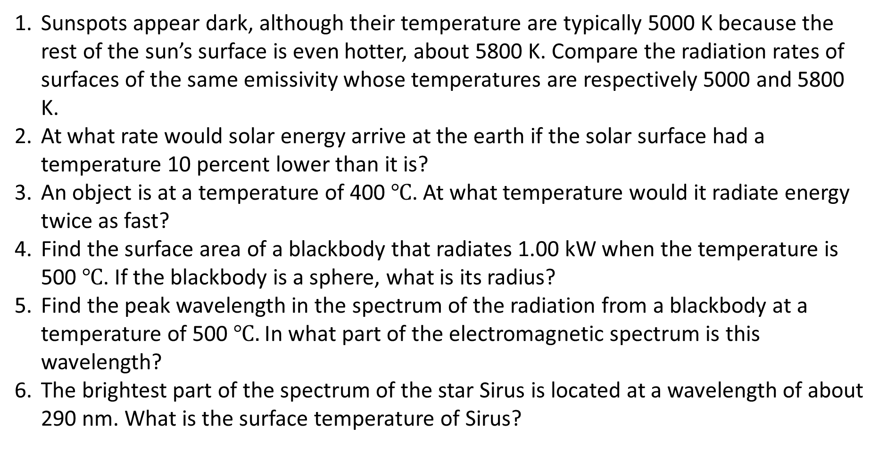
Problems
Sunspots appear dark, although their temperature are typically 5000 K because the rest of the sun’s surface is even hotter, about 5800 K. Compare the radiation rates of surfaces of the same emissivity whose temperatures are respectively 5000 and 5800 K.
At what rate would solar energy arrive at the earth if the solar surface had a temperature 10 percent lower than it is?
An object is at a temperature of 400 $℃$. At what temperature would it radiate energy twice as fast?
Find the surface area of a blackbody that radiates 1.00 kW when the temperature is 500$℃$. If the blackbody is a sphere, what is its radius?
Find the peak wavelength in the spectrum of the radiation from a blackbody at a temperature of 500$℃.$ In what part of the electromagnetic spectrum is this wavelength?
The brightest part of the spectrum of the star Sirus is located at a wavelength of about 290 nm. What is the surface temperature of Sirus?

Slide 16
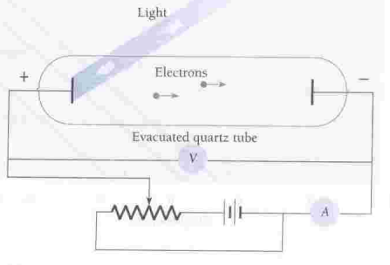
Photo-electric Effect
The phenomenon of emission of electrons from a metal surface when light of certain frequency is shine on it is know as photo electric effect, and the emitted electrons are known as photo electron.

Slide 17
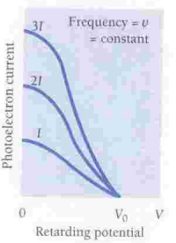
Few Observations
Within the limit of experimental accuracy there is no time delay between shinning of light and emission of electrons. If light behaves as waves it should take finite amount of time to accumulate energy to free an electron from the atomic binding.
A bright light yields more photoelectrons than a dim one of the same frequency, but the electron energies remain the same. The em theory of light, on the contrary, predicts that the more intense the light, the greater the energy of electrons.

Slide 18
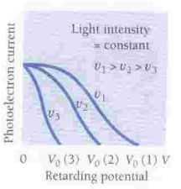
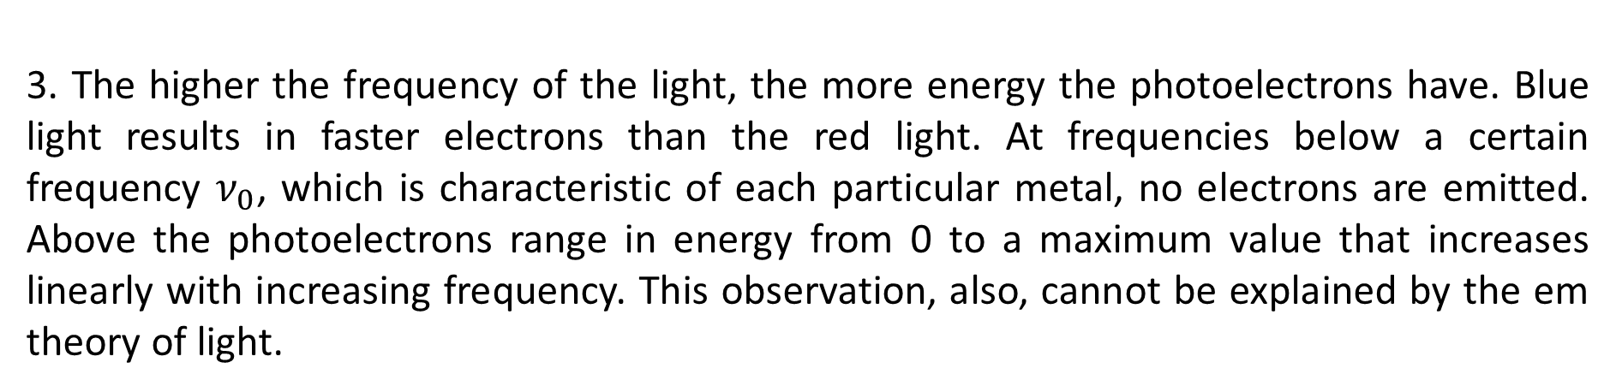
3. The higher the frequency of the light, the more energy the photoelectrons have. Blue light results in faster electrons than the red light. At frequencies below a certain frequency $ν_{0}$, which is characteristic of each particular metal, no electrons are emitted. Above the photoelectrons range in energy from 0 to a maximum value that increases linearly with increasing frequency. This observation, also, cannot be explained by the em theory of light.

Slide 19
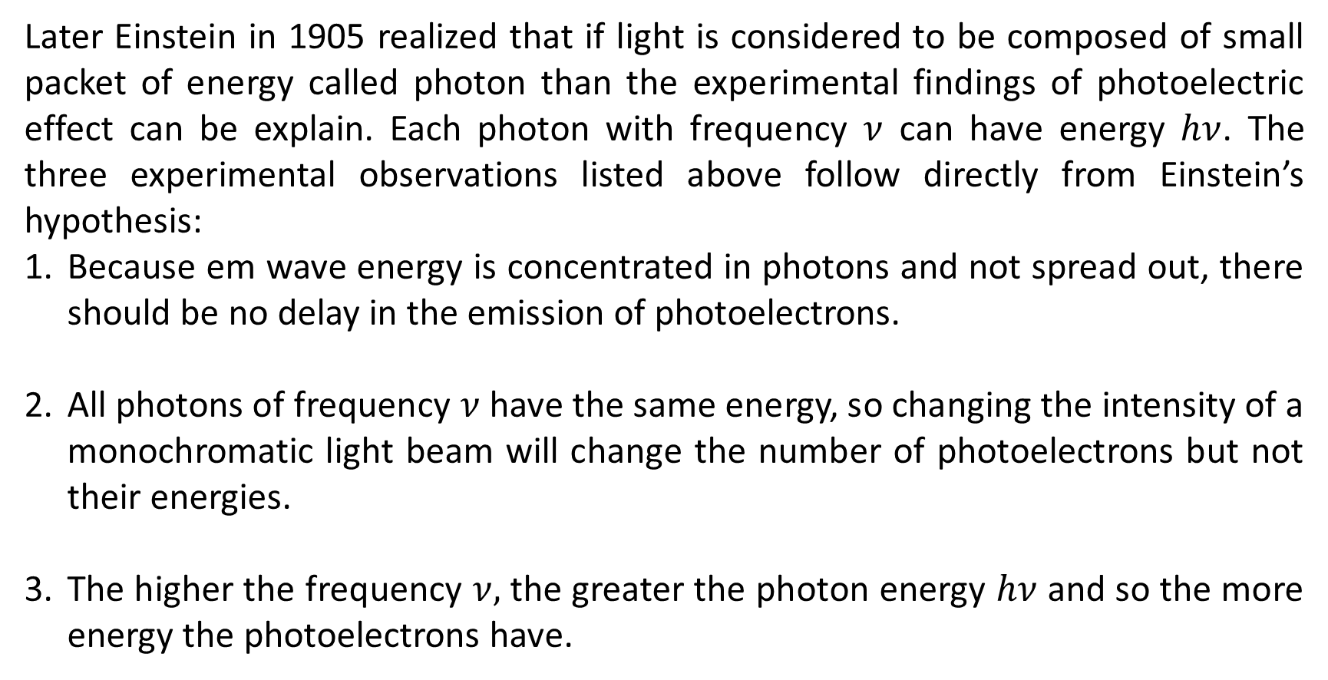
Quantum Mechanical Solutions
Later Einstein in 1905 realized that if light is considered to be composed of small packet of energy called photon than the experimental findings of photoelectric effect can be explain. Each photon with frequency $ν$ can have energy $hν$. The three experimental observations listed above follow directly from Einstein’s hypothesis:
Because em wave energy is concentrated in photons and not spread out, there should be no delay in the emission of photoelectrons.
All photons of frequency $ν$ have the same energy, so changing the intensity of a monochromatic light beam will change the number of photoelectrons but not their energies.
The higher the frequency $ν,$ the greater the photon energy $hν$ and so the more energy the photoelectrons have.

Slide 20
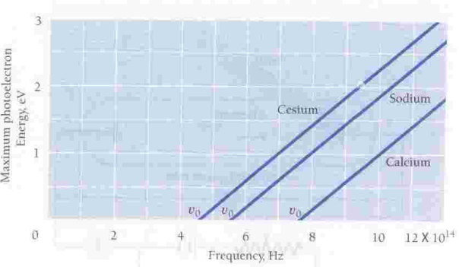
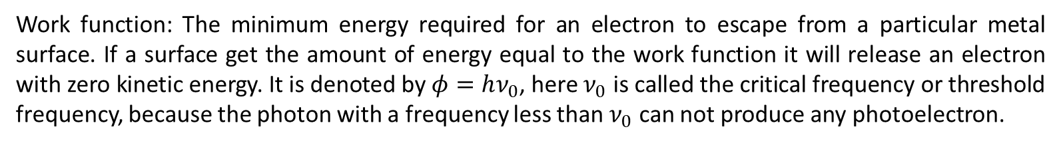
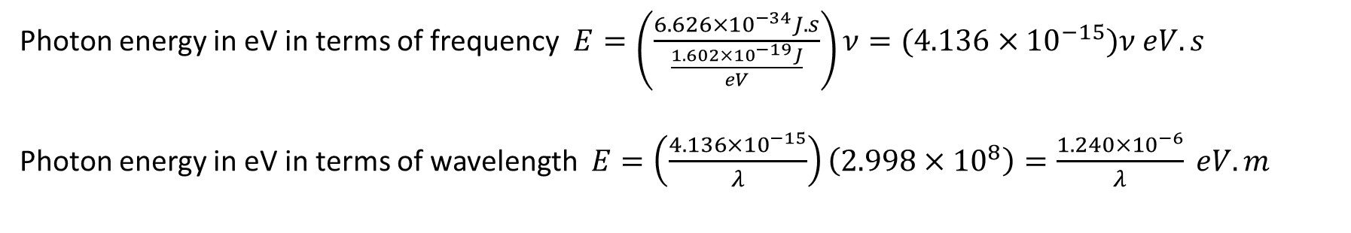
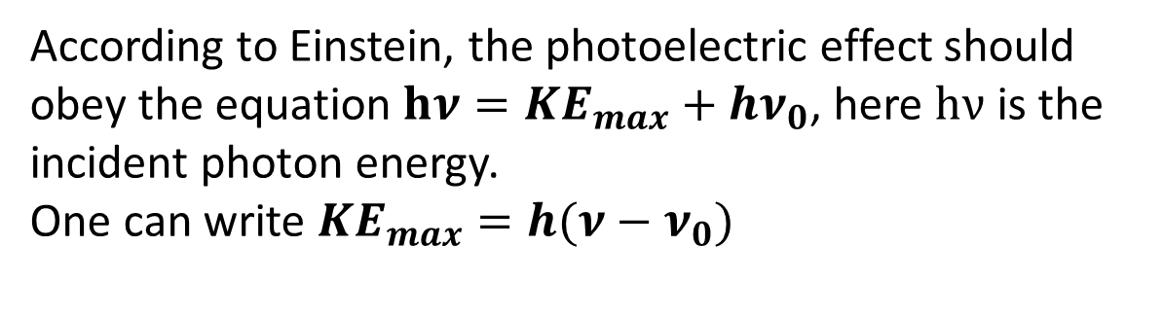
Work function and Einstein Equation
Work function: The minimum energy required for an electron to escape from a particular metal surface. If a surface get the amount of energy equal to the work function it will release an electron with zero kinetic energy. It is denoted by $φ=hν_{0}$, here $ν_{0}$ is called the critical frequency or threshold frequency, because the photon with a frequency less than $ν_{0}$ can not produce any photoelectron.
According to Einstein, the photoelectric effect should obey the equation $hν={KE}_{max}+hν_{0}$, here $hν$ is the incident photon energy.
One can write ${KE}_{max}=h(ν−ν_{0})$
Photon energy in eV in terms of frequency $E=\left(\frac{{6.626×10}^{−34}J.s}{\frac{{1.602×10}^{−19}J}{eV}}\right)ν={(4.136×10}^{−15})ν eV.s$
Photon energy in eV in terms of wavelength $E=\left(\frac{{4.136×10}^{−15}}{λ}\right)\left({2.998×10}^{8}\right)=\frac{{1.240×10}^{−6}}{λ} eV.m$

Slide 21
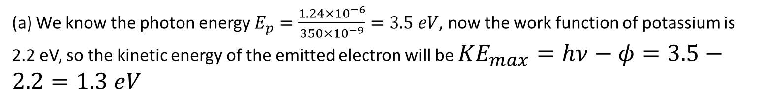
Ultraviolet light of wavelength 350 nm and intensity 1.00 W/m² is directed at a potassium surface. Find the maximum KE of the photoelectrons.
(a) We know the photon energy $E_{p}=\frac{{1.24×10}^{−6}}{350×{10}^{−9}}=3.5 eV$, now the work function of potassium is 2.2 eV, so the kinetic energy of the emitted electron will be ${KE}_{max}=hν−φ=3.5−2.2=1.3 eV$

Slide 22
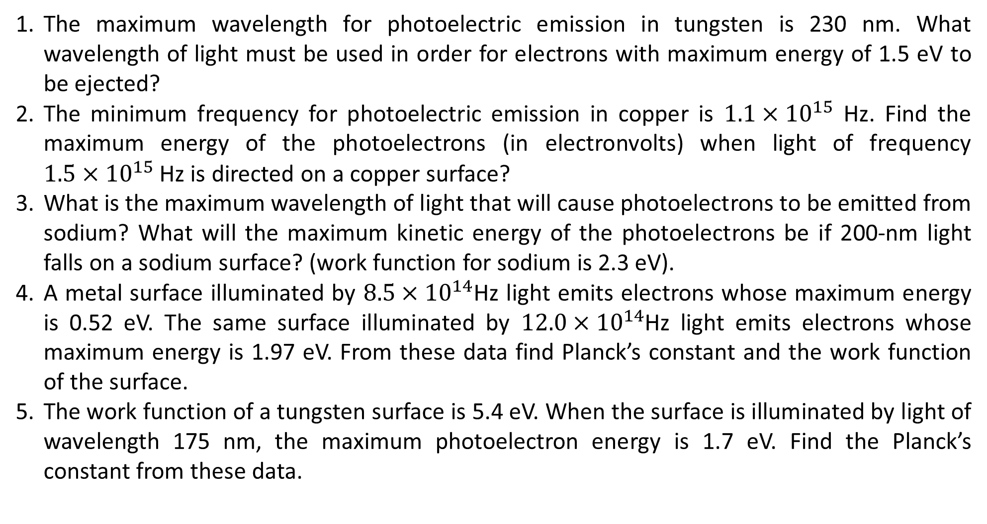
Problem Set
The maximum wavelength for photoelectric emission in tungsten is 230 nm. What wavelength of light must be used in order for electrons with maximum energy of 1.5 eV to be ejected?
The minimum frequency for photoelectric emission in copper is ${1.1×10}^{15}$ Hz. Find the maximum energy of the photoelectrons (in electronvolts) when light of frequency ${1.5×10}^{15}$ Hz is directed on a copper surface?
What is the maximum wavelength of light that will cause photoelectrons to be emitted from sodium? What will the maximum kinetic energy of the photoelectrons be if 200-nm light falls on a sodium surface? (work function for sodium is 2.3 eV).
A metal surface illuminated by ${8.5×10}^{14}$Hz light emits electrons whose maximum energy is 0.52 eV. The same surface illuminated by ${12.0×10}^{14}$Hz light emits electrons whose maximum energy is 1.97 eV. From these data find Planck’s constant and the work function of the surface.
The work function of a tungsten surface is 5.4 eV. When the surface is illuminated by light of wavelength 175 nm, the maximum photoelectron energy is 1.7 eV. Find the Planck’s constant from these data.

Slide 23
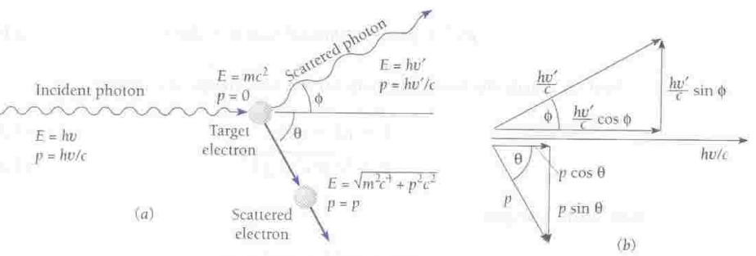
Compton Effect
When a photon strikes an electron (assumed to be at rest ) and is scattered away from its original direction of motion while the electron receives an impulse and begins to move. This phenomenon is called Compton effect. In this case, the photon loses kinetic energy and the electron gains the same amount of energy.

Slide 24
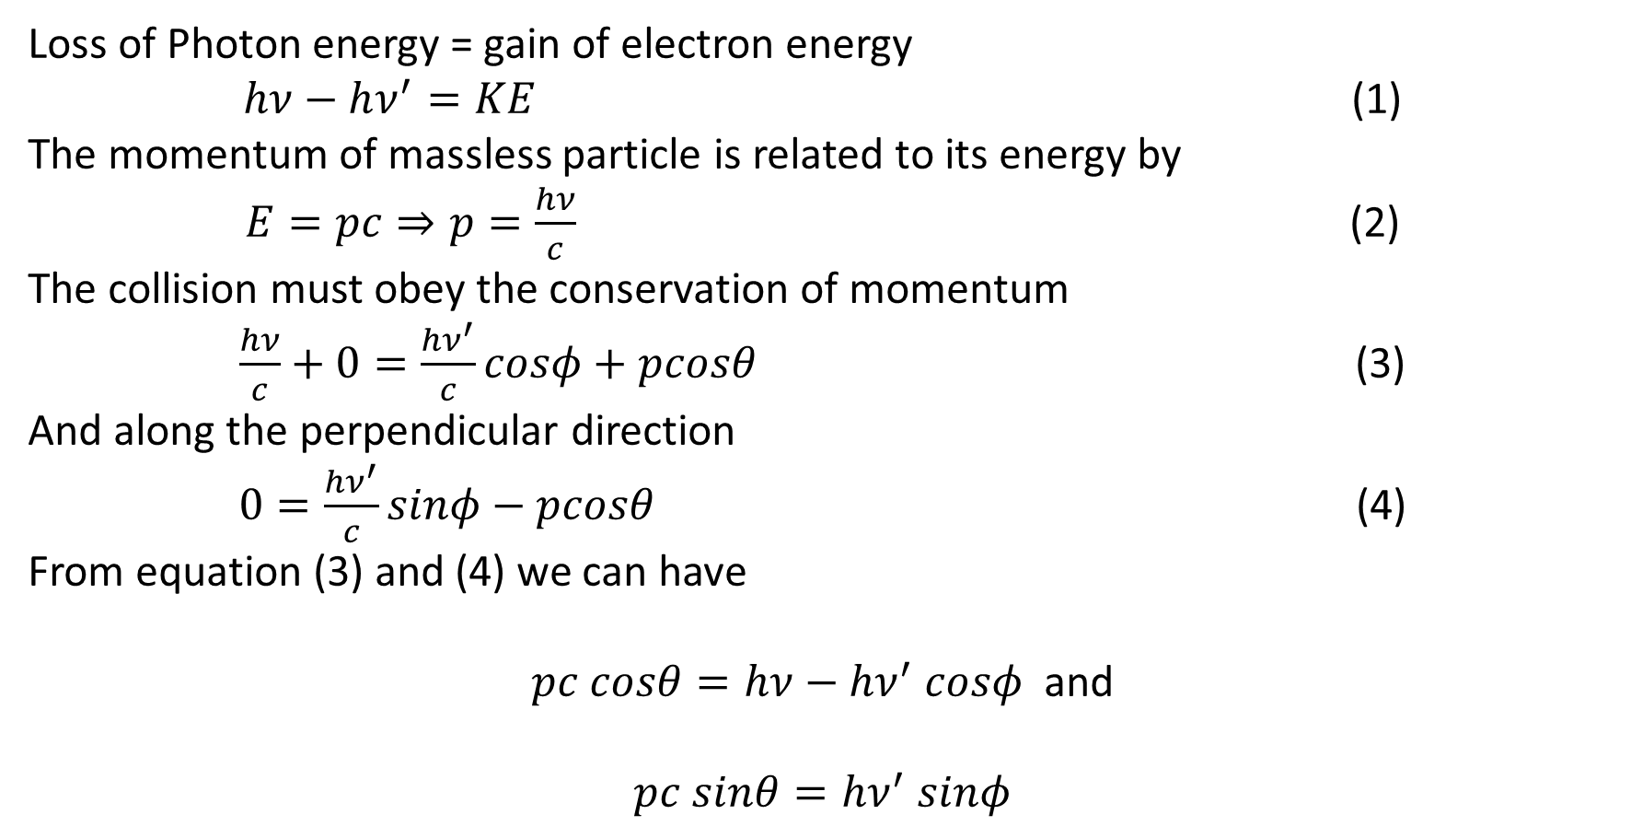
Loss of Photon energy = gain of electron energy
$hν−hν^{′}=KE$ (1)
The momentum of massless particle is related to its energy by
$E=pc⇒p=\frac{hν}{c}$ (2)
The collision must obey the conservation of momentum
$\frac{hν}{c}+0=\frac{hν^{′}}{c}cosφ+pcosθ$ (3)
And along the perpendicular direction
$0=\frac{hν^{′}}{c}sinφ−pcosθ$ (4)
From equation (3) and (4) we can have
$pc cosθ=hν−{hν}^{′} cosφ$ and
$$pc sinθ={hν}^{′} sinφ$$

Slide 25
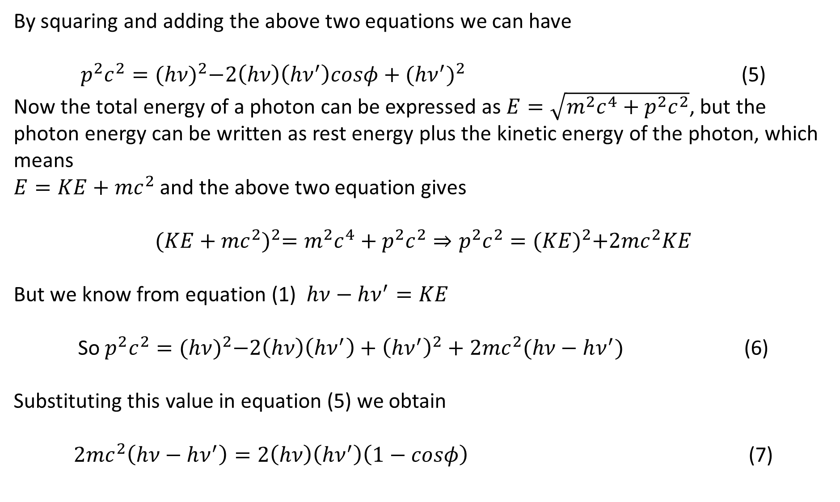
By squaring and adding the above two equations we can have
$p^{2}c^{2}={(hν)}^{2}−2\left(hν\right)\left({hν}^{′}\right)cosφ+{({hν}^{′})}^{2}$ (5)
Now the total energy of a photon can be expressed as $E=\sqrt{m^{2}c^{4}+p^{2}c^{2}}$, but the photon energy can be written as rest energy plus the kinetic energy of the photon, which means
$E=KE+{mc}^{2}$ and the above two equation gives
$${(KE+{mc}^{2})}^{2}=m^{2}c^{4}+p^{2}c^{2}⇒p^{2}c^{2}={(KE)}^{2}+2{mc}^{2}KE$$
But we know from equation (1) $hν−hν^{′}=KE$
So $p^{2}c^{2}={(hν)}^{2}−2\left(hν\right)\left(hν^{′}\right)+{\left(hν^{′}\right)}^{2}+2{mc}^{2}(hν−hν^{′})$ (6)
Substituting this value in equation (5) we obtain
$2{mc}^{2}\left(hν−hν^{′}\right)=2\left(hν\right)\left({hν}^{′}\right)\left(1−cosφ\right)$ (7)

Slide 26
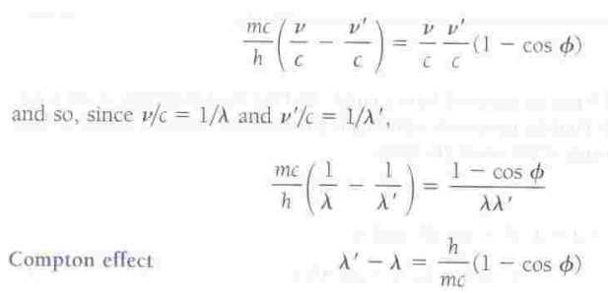
This equation was derived by Compton in 1920, and the phenomenon it described is know as Compton effect.

Slide 27
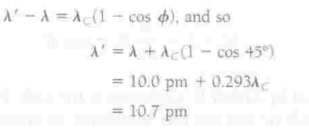
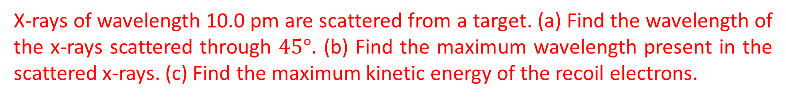

The quantity $λ_{c}=\frac{h}{mc}$ is known as the Compton wavelength of the scattering particle.
For an electron $λ_{c}={2.426×10}^{−12}$ m.
X-rays of wavelength 10.0 pm are scattered from a target. (a) Find the wavelength of the x-rays scattered through $45°$. (b) Find the maximum wavelength present in the scattered x-rays. (c) Find the maximum kinetic energy of the recoil electrons.
(a)

Slide 28

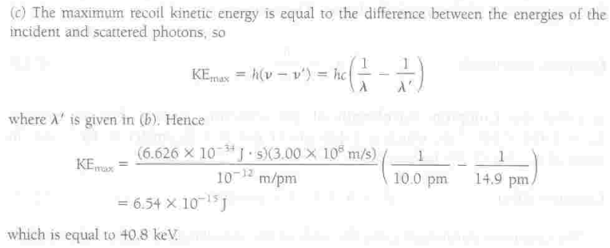

Slide 29
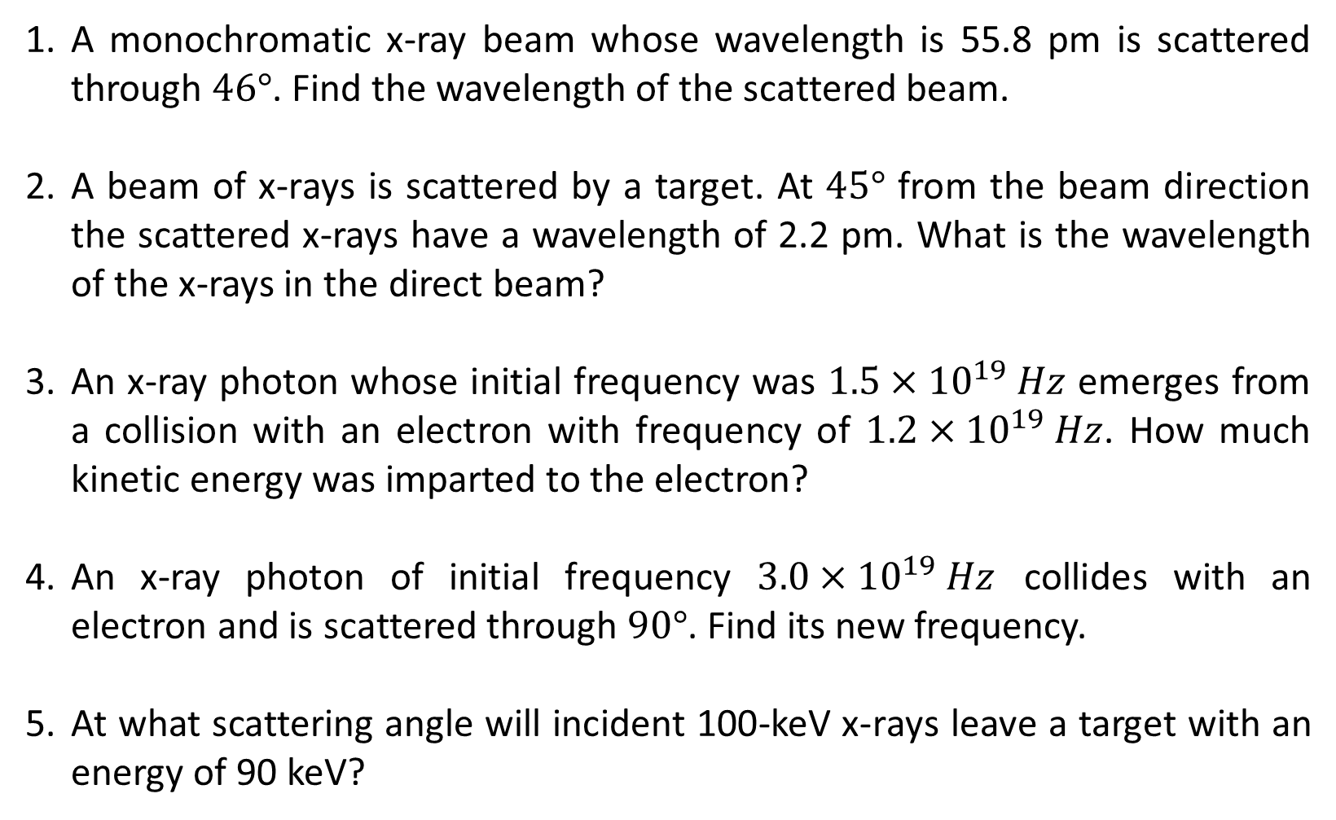
A monochromatic x-ray beam whose wavelength is 55.8 pm is scattered through $46°$. Find the wavelength of the scattered beam.
A beam of x-rays is scattered by a target. At $45°$ from the beam direction the scattered x-rays have a wavelength of 2.2 pm. What is the wavelength of the x-rays in the direct beam?
An x-ray photon whose initial frequency was ${1.5×10}^{19} Hz$ emerges from a collision with an electron with frequency of ${1.2×10}^{19} Hz$. How much kinetic energy was imparted to the electron?
An x-ray photon of initial frequency ${3.0×10}^{19} Hz$ collides with an electron and is scattered through $90°$. Find its new frequency.
At what scattering angle will incident 100-keV x-rays leave a target with an energy of 90 keV?

Slide 30
X-RAYS
From photoelectric effect we come to know that photon can transfer its energy to electron, can the opposite process is possible? That is can the kinetic energy of an electron be converted to a photon?
In1895 Wilhelm Roentgen found that a highly penetrating radiation of unknown nature is produced when fast electrons impinge on matter, this is called x-rays.
It travel in straight line
It is unaffected by electric and magnetic field.
It passes through opaque materials
It causes phosphorescent substance to glow
The faster the original electrons, the more penetrating the resulting x-rays
The greater the number of electrons, the greater the intensity of the x-ray beam
Electromagnetic radiation with wavelength 0.01-10 nm falls into the x-ray catagory

Slide 31
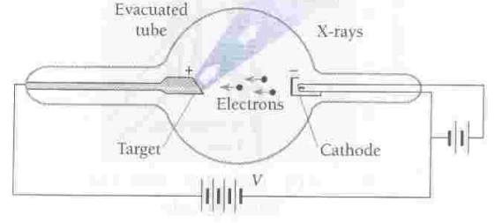
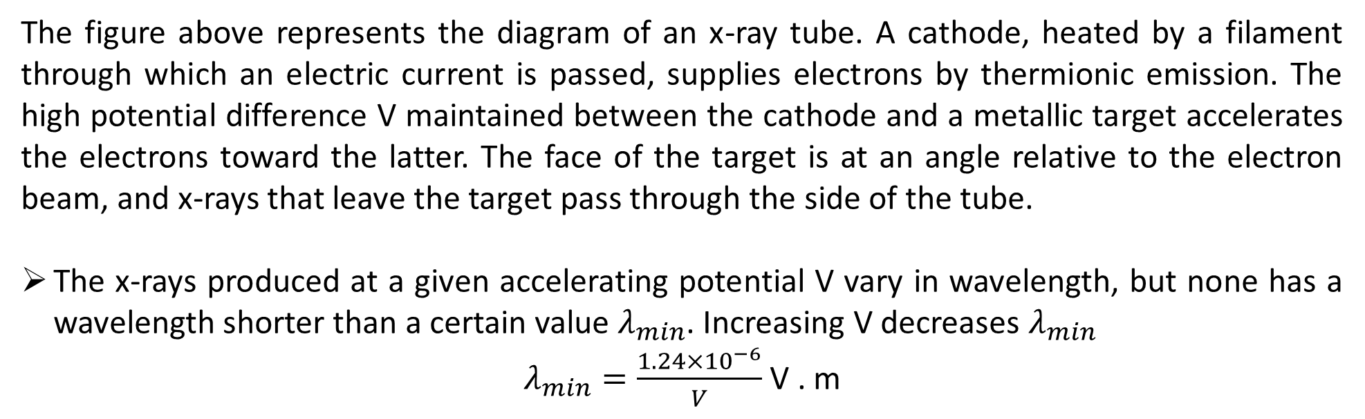
The figure above represents the diagram of an x-ray tube. A cathode, heated by a filament through which an electric current is passed, supplies electrons by thermionic emission. The high potential difference V maintained between the cathode and a metallic target accelerates the electrons toward the latter. The face of the target is at an angle relative to the electron beam, and x-rays that leave the target pass through the side of the tube.
The x-rays produced at a given accelerating potential V vary in wavelength, but none has a wavelength shorter than a certain value $λ_{min}$. Increasing V decreases $λ_{min}$
$λ_{min}=\frac{{1.24×10}^{−6}}{V}$ V . m

Slide 32
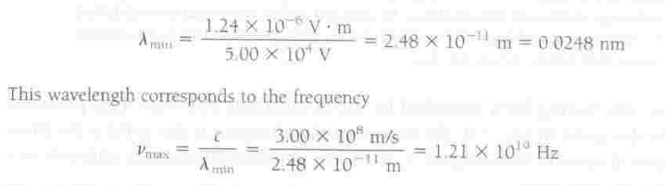
Find the shortest wavelength and greatest frequency present in the radiation from an x-ray machine whose accelerating potential is 50,000 V.

Slide 33
What voltage must be applied to an x-ray tube for it to emit x-rays with a minimum wavelength of 30 pm?
Electrons are accelerated in television tubes through potential differences of about 10 kV. Find the highest frequency of the electromagnetic waves emitted when these electrons strike the screen of the tube. What kind of waves are these?

Slide 34

De Broglie Waves
A moving body behaves in certain ways as though it has a wave nature.
A photon of frequency $ν$ has the momentum $p=\frac{hν}{c}=\frac{h}{λ}$
The wavelength of the photon is therefore
$λ=\frac{h}{p}$ (1)
Equation (1) is a general equation for any particles. The momentum of a particle of mass m and velocity v is $p=γmv$, so de Broglie wavelength is
$λ=\frac{h}{γmv}$ (2)
Where $γ=\frac{1}{\sqrt{1−\frac{v^{2}}{c^{2}}}}$

Slide 35



Find the de Broglie wavelengths of (a) a 46-g golf ball with a velocity of 30 m/s, and (b) an electron with a velocity of ${10}^{7}$m/s.

Slide 36

Find the kinetic energy of a proton whose de Broglie wavelength is 1 fm=1x10⁻¹⁵ m, which is roughly the diameter of a proton.
A relativistic calculation is needed unless pc for the proton is much smaller than the proton rest energy
$$E_{0}=0.938 GeV$$
$$pc=\frac{hc}{λ}=\frac{({6.626×10}^{−34} J.s)({2.998×10}^{8}m/s)}{{1.00×10}^{−15} m}={19.86×10}^{−11}J$$
$$\frac{{19.86×10}^{−11}J }{{1.6×10}^{−19}}={1.241×10}^{9} eV=1.241 GeV$$
So, the total energy of the proton is
$$E=\sqrt{{E_{0}}^{2}+p^{2}c^{2}}=\sqrt{{(0.938)}^{2}+{(1.241)}^{2}}=1.555 GeV$$
Kinetic energy $KE=E−E_{0}=\left(1.555−0.938\right)GeV=0.617 GeV=617 MeV$

Slide 37

In water waves, the quantity that varies periodically is the height of the water surface, in sound waves it is pressure, in light waves it is electric and magnetic field. What is varies in case of matter wave?? The answer is wave function, denoted by the symbol $Ψ$.
What is the physical significance of wave function $Ψ$
The value of the wave function associated with a moving body at the particular point x,y,z in space and time t is related to the likelihood of finding the body there at the time. The wave function does not have any direct physical significance since there is no direct experimental evidence of measurement of $Ψ$. The probability of experimentally finding the body described by the wave function $Ψ$ at the point x,y,z at the time t is proportional to the value ${|Ψ|}^{2}$ there at t. A large value of probability means the more chance of finding the particle there and small value of ${|Ψ|}^{2}$ means less chance of finding the particle in that particular place.

Slide 38
DAVISSON GERMER EXPERIMENT
In 1923 Louise de Broglie suggested that like radiation matter also posses duel nature that are particle and wave. According to him a particle of mass m moving with velocity v always associated with a wave with wavelength λ=h/p here h is Plank’s constant and p is momentum of the particle. In 1926Walter Maurice Elsasser suggested that wave like nature of matter might be invested by electrons scattering experiment in crystalline solids.
In 1927 Davisson and Germer proved that fast moving electrons show diffraction effect (property of waves)and calculated the wave length of electrons wave.
In the same time G P Thomson also proved experimentally the wave nature of electrons.

Slide 39

Davisson and Germer Experiment: The Davisson and Germer experiment confirmed the earlier hypothesis of de Broglie which demonstrated the wave nature of the electrons,. This experiment confirms that electrons exhibit diffraction pattern when they are scattered from a crystal plane .
Davisson and Germer Apparatus: In this apparatus the energy of the electrons in the primary beam can be varied with the angle at which they are incident upon the nickel crystal target . The crystal and the detector was kept on a rotating plane.

Slide 40
An electron beam from an electron gun then is fired at the nickel crystal.
The electron gun was a heated tungsten filament. The thermally excited electrons were then accelerated through an electric potential difference, giving them a certain amount of kinetic energy, towards the nickel crystal.
The experiment was conducted in a vacuum chamber to avoid collisions of the electrons with other atoms on their way.
To measure the number of electrons that were scattered at different angles, a faraday cup electron detector was used. The number of reflected electrons varied as the angle between the detector and the incident electron beam varied.
The detector was designed to accept only elastically scattered electrons with high velocity at angles between 20 ͦand 90 ͦ.

Slide 41
According to the classical physics the scattered electrons should emerge in all directions with only a moderate dependence of their intensity upon scattering angle and even less upon the energy of the primary electrons.
During the experiment an accident occurred that allowed air to enter the apparatus and oxidize the metal surface.
To reduce the oxide to pure nickel the target was baked in high temperature oven. After heating the target was returned to the apparatus and measurements resumed.
Surprisingly, instead of a continuous variation of scattered electron intensity with angle distinct maxima and minima were observed whose position depended on the electron energy

Slide 42


Slide 43
What is the reason for this new effect? De Broglie hypothesis suggested that the electrons waves were being diffracted by the target much as X rays are diffracted by Bragg reflection from crystal planes. Why did it not appear until after the Ni target was baked?
It was realized that the effect of heating a block of nickel at high temperature caused many small individual crystals of which it was composed to form into a single large crystal, all of these atoms got arranged in a regular lattice.

Slide 44
When the angle between the incident beam and the scattered beam become 50 ͦ the detector shows maximum numbers of electron scattering. The maximum numbers of reflected electrons in the detector indicate that electrons are being diffracted. In such a case applying Bragg’s law we can write ,
2dsinθ=nλ here θ is Glancing angle so λ= 2x 0.91x sin 65 ͦ for nickel d = 0.91 A ͦ = 1.82x 0.9063 =1.65 A ͦ and for 1st order n=1
λ = 1.65 A ͦis the experimental value of wavelength associated with an electron considering it to be associated with a wave.

Slide 45


Slide 46



The Uncertainty Principle
A narrow de Broglie wave, the position of the particle can be precisely determined but the wavelength can not be since there no enough number of waves. That is why the momentum can not be precisely determined since $p=\frac{hν}{c}=\frac{h}{λ}$
A large de Broglie wave, the momentum of the particle can be precisely determined but the position can not be since it is spread over a wide range of space.
Uncertainty Principle: It is impossible to know both the exact position and exact momentum of an object at the same time.
Werner Heisenberg 1927

Slide 47

Proof

Slide 48


Slide 49


Slide 50

The Energy Time Uncertainty

Slide 51


A measurement establishes the position of a proton with an accuracy of $±{1.00×10}^{−11}$ m. Find the uncertainty in the proton’s position 1.00 s later.

Slide 52

A typical atomic nucleus is about ${5.0×10}^{−15}$ m in radius. Use the uncertainty principle to place a lower limit on the energy an electron must have if it is to be part of a nucleus.

Slide 53


A hydrogen atom is ${5.3×10}^{−11}$ m in radius. Use the uncertainty principle to estimate the minimum energy at electron can have in this atom.

